Slide 1


(Football Tournament Manager)
Group members:
Parth Patil (220943020062)
Shantanu Patil (220943020066)
Soham Ghatpande (220943020100)

Slide 2
CONTENTS
Introduction
Working
Features
Technologies Used
Applications
Future Scopes
Conclusion

Slide 3
INTRODUCTION
In India many football teams play various tournaments which are not managed properly.
Inefficient way of managing Tournaments.
In Tech-savvy age, paper pen type of methos are used by Tournament Organizers and Managers
The main objective of this project is to build a website for these organizers, to organize tournaments and managing it through our web application
Through this system, they can manage and maintain all the data related to these tournaments.

Slide 4
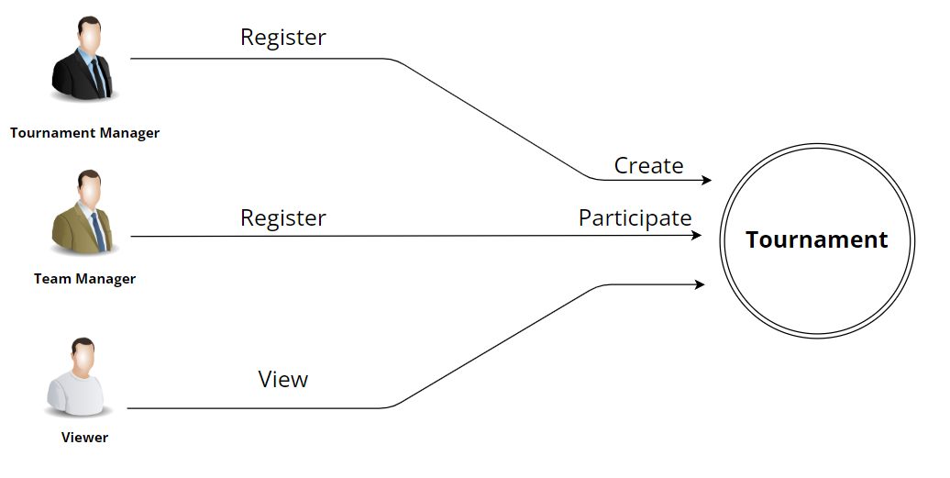
WORKING
Separate Logins for 4 different Users
Admin
Tournament Manager
Team Manager
Match Updater

Slide 5
FEATURES
Create Tournaments (Tournament Manager)
Create Matches (Tournament Manager)
Register Teams (Team Manager)
Participate In Tournaments (Team Manager)
Score Update (Match Updater)
View Tournaments (Viewer)
View Teams (Viewer)
View Matches (Viewer)
View Score (Viewer)

Slide 6
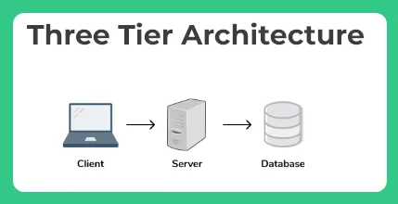
TECHNOLOGIES USED
Client : React JS, Bootstrap
Server : Java, Spring Boot REST API
Database : MySQL

Slide 7
APPLICATIONS
Tournament Hosting.
Players Data Access.
Teams Data Access.
To make analysis of local Talent.

Slide 8
FUTURE SCOPES
New Modes of Tournament – Currently we have only a Knock-Out mode in our system but in future, we are planning to add Round-Robin, Groups-Stage, etc.
Choosing Players from the Existing record – We will add a Feature to add existing players while creating a new team for a tournament.
Viewer’s Features – In the Updated Version More Features will be given to the viewers like Match Prediction, Comments, Live Commentary, etc.
Sponsors will be able to Sponsor a Tournament/Teams.

Slide 9
CONCLUSION
Our system will provide a platform for local organizers to organize a tournament in a sorted manner.
The local teams and their players will get recognition.
With this system Resources will be managed in a better way.
From viewers point they will have the ability to track their favorite Teams and Players.

Slide 10
THANK YOU

